Slide 1

File Management system
Operating system lab

Slide 2




Meet our team
Md.Raihan sharker
Md.saif Uddin bhuiyan
md.Shakibul alam
Synthia Rahman shithi
Id:2125051073
Id:2125051083
Id:2125051093
Id:2125051017

Slide 3

Agenda
Introduction
Features
Menu options
Code overview
Code output
benefits

Slide 4

Introduction
This project is a File Management System implemented in C++.
It supports various file operations such as creation, reading, writing, deletion, renaming, copying, sorting, and merging.
This system demonstrates the use of file handling concepts in the Operating Systems course.

Slide 5

Features
Create new file
Write data
Read
data
Delete
file
Sort
file
Rename file
Copy
file
Merge
File

Slide 6

Menu Options
Create File
Read File
Sort file
Write to File
Delete file
Rename file
Copy file
Merge file

Slide 7




Code Overview
Functions for each file operation
create, write, read, delete
C++ libraries
<fstream>, <vector>, <algorithm>, and <string>.
A menu-driven interface for user interaction.
Proper error handling for file operations.

Slide 8

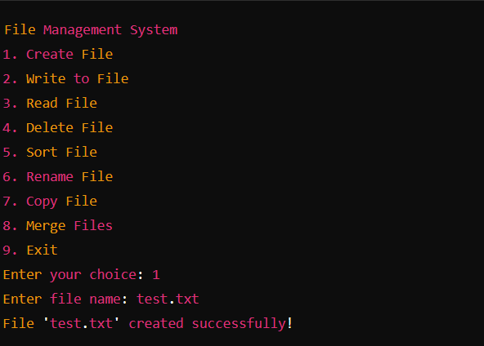
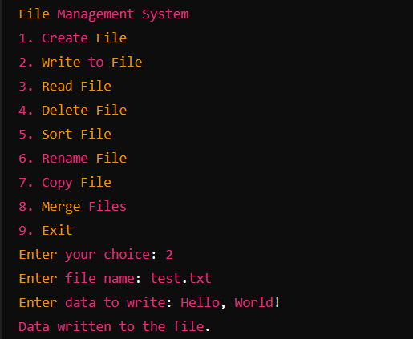
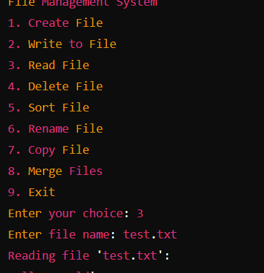
Code output

Slide 9

Benefits
- Demonstrates practical use of file handling in C++.
- Offers a user-friendly interface for file management.
- Provides a comprehensive understanding of file operations.
- Useful for learning the fundamentals of Operating Systems concepts.

Slide 10


Ask Any questions?

Slide 11


Thank you

